Slide 1
Machine learning
Implied volatility Pricing & Credit risk analytics
Qiuan Wu, Xiaotian Zhu, Yuchen Wu

Slide 2
Selective Learning Analytics

Slide 3
Data processing and Visualization
Split NBoptions data into OTM, ITM, and NTM
To get NTM option, set the threshold as 0.5
Standard Normalization
Conduct dimension reduction with PCA, TSNE, UMAP to Put option and Call option separately
Data | # Instances
OTM | 8150
ITM | 8150
NTM | 915

Slide 4
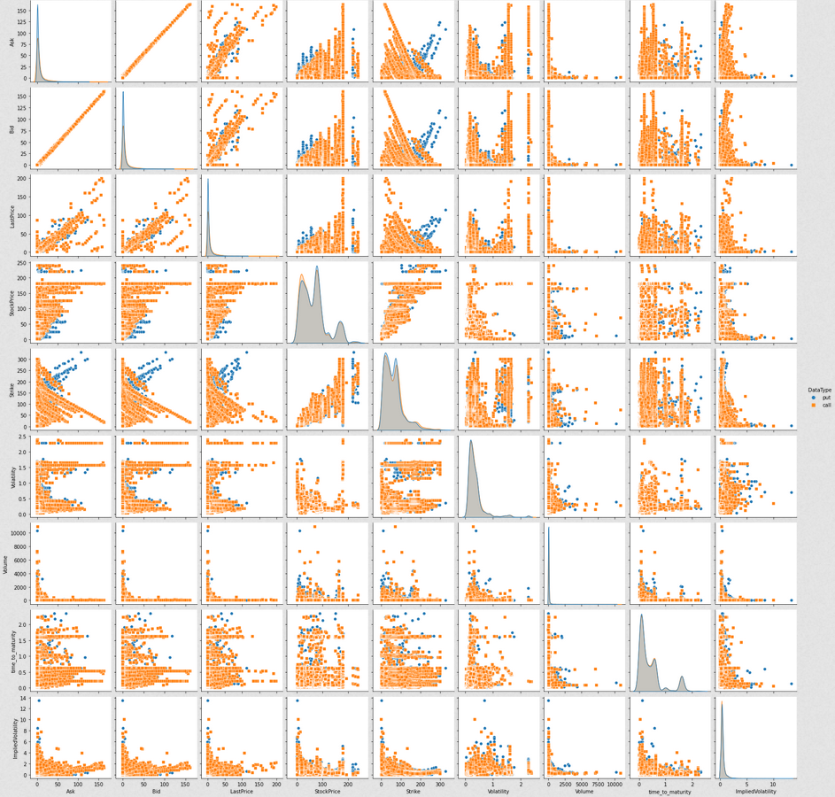
NPoptions Pairplot

Slide 5
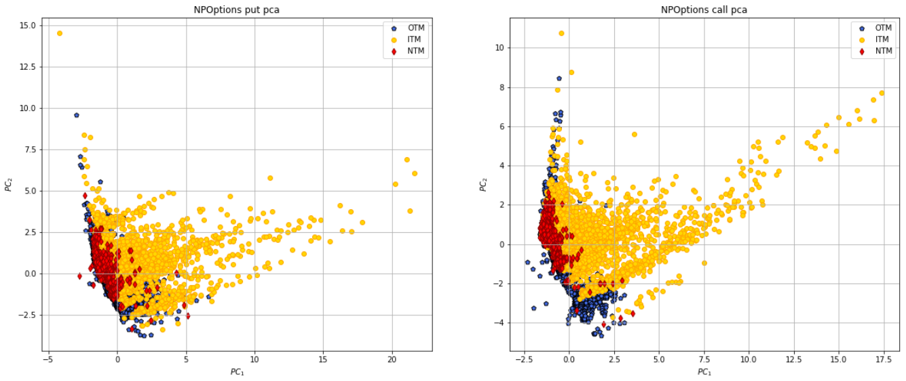
PCA Visualization

Slide 6
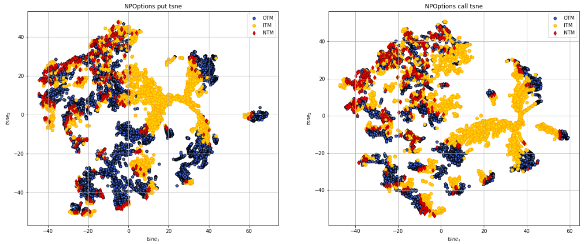
TSNE Visualization(Perplexity = 100)

Slide 7
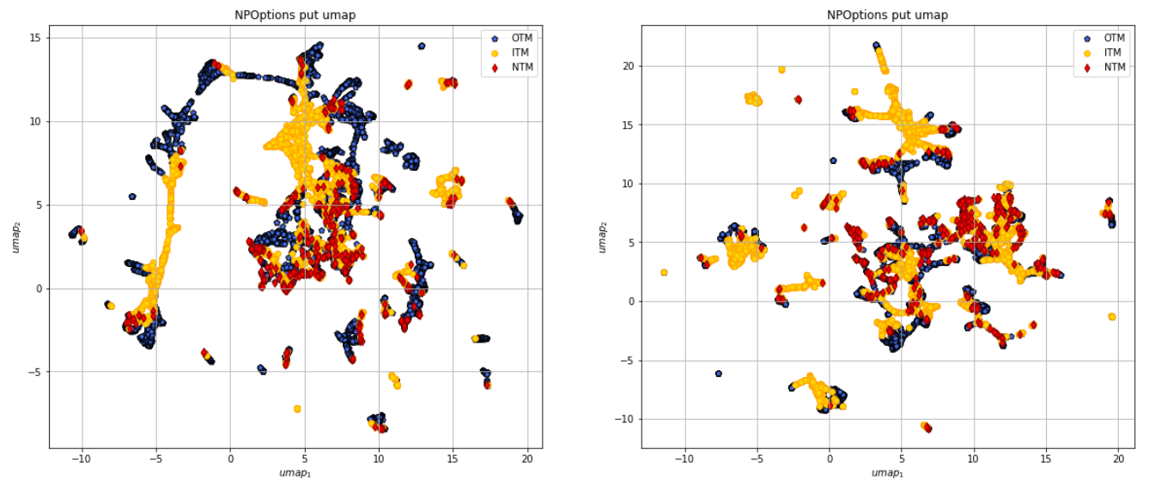
UMAP Visualization

Slide 8
Learning Process
Regular Machine Learning:
Partition Option data into train_data (80%) and test_data (20%)
Conduct machine learning to train_data and test_data; calculate MSE and Q3
Selective Learning:
Partition train_data into train_train (80%) and train_test (20%)
Get the prediction error of train_test
Find bad_guys by finding the top 10% instances of the prediction error
For each bad_guys, find the 10 nearest neighbors in train_train, 5 nearest neighbors in test_data

Slide 9
Learning Process (Cont)
Get train_clean by removing (bad_guys + neighbors in train_train) from train_data; get test_clean by removing (bad_guys + neighbors in test_data)
Conduct machine learning to train_clean and test_clean; calculate MSE and Q3
Adaptive Learning:
For each bad_guys neighbors (potential bad guys) in test_data, find the 10 nearest neighbors in train_clean
Get adaptive_train from the neighbors
Conduct machine learning to adaptive_train_clean and test_clean; calculate MSE and Q3
Finally, Compare results

Slide 10
Machine Learning Algorithms
K-nearest neighbors (kNN), using euclidean distance
Support Vector Machine (SVM), using linear kernel
Random Forest
Gradient Boosting
Deep Neural Network (DNN) (Does not work coz it runs for too long)

Slide 11
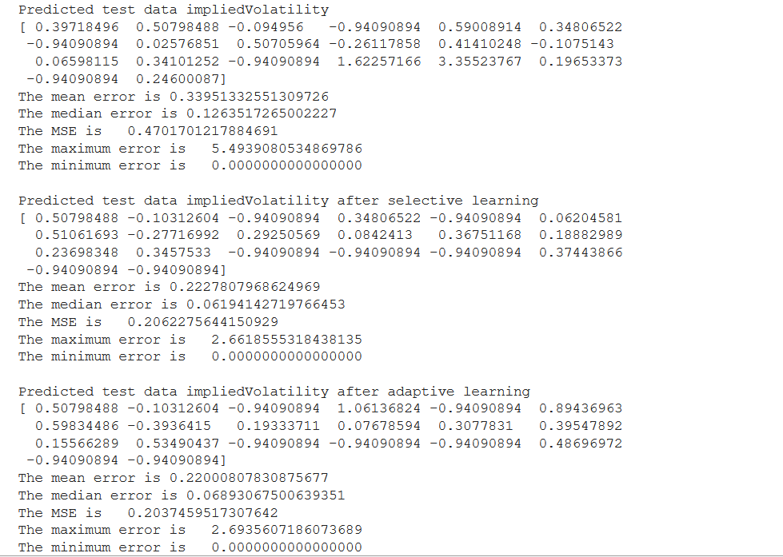
An example of machine learning output

Slide 12
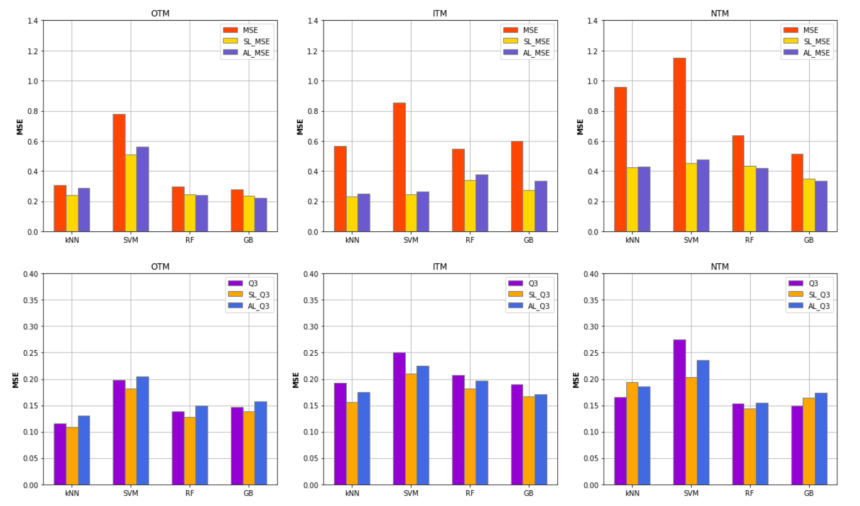

Slide 13
Summary for NBoptions
Fitting: OTM > ITM > NTM
OTM fits slightly better because it has less outliers than ITM according to the PCA plot; The reason is that OTM is not traded as frequently as ITM options and the price is more stable
NTM fits the worst because it has only around 900 instances, while OTM and ITM have 8000+ instances
Selective learning improves the learning accuracy in most cases
Adaptive learning only improves the learning accuracy in very few cases
SVM performance yield the highest MSE and Q3, while the other algorithms perform similarly

Slide 14
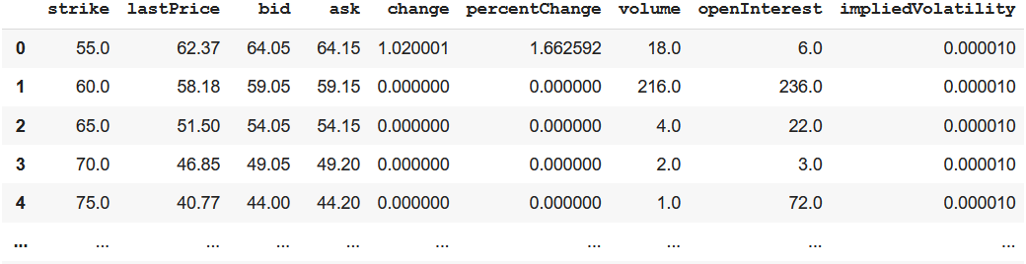
Own Option Data
Option: AAPL
Expiration Date: ['2020-12-04', '2020-12-11', '2020-12-18', '2020-12-24', '2020-12-31', '2021-01-08', '2021-01-15', '2021-02-19', '2021-03-19', '2021-04-16', '2021-06-18', '2021-07-16', '2021-09-17', '2022-01-21', '2022-06-17', '2022-09-16', '2023-01-20']

Slide 15
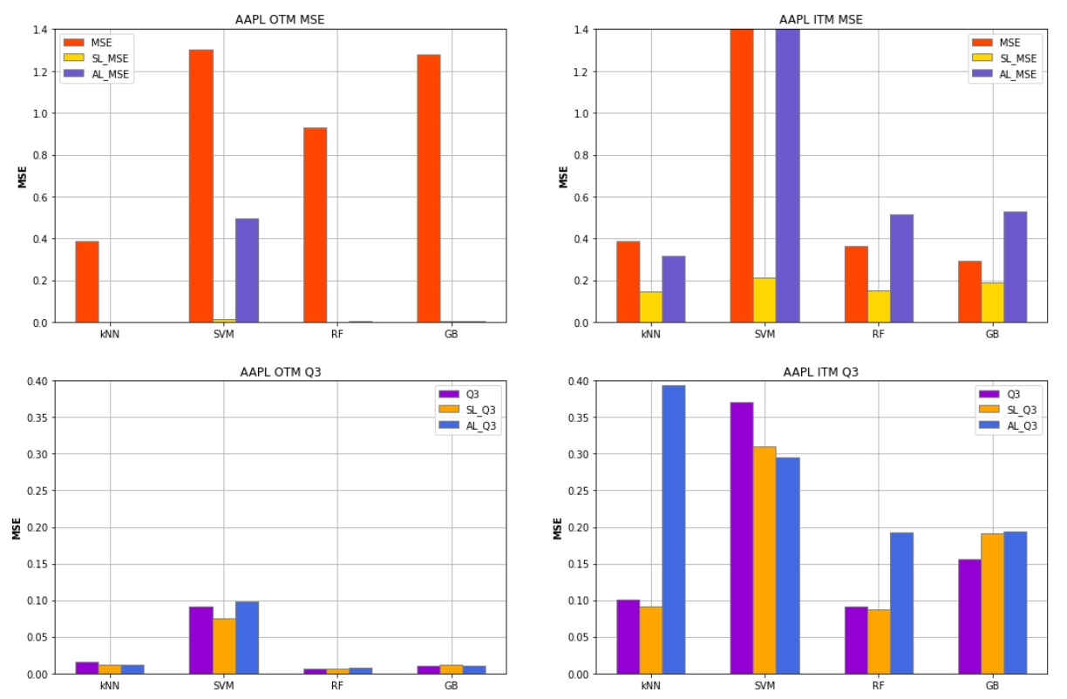

Slide 16
Revisit Credit Risk Analytics (I)

Slide 17
Steps
And Visualization
Label data according to its Delinquency.
Delinquency: this is a binary variable 1: means bad credit and 0: means good credit
Data Visualization
Partition data as 80% for training and 20% for testing and use K-NN and SVM, to conduct credit risk analytics
Compute all classification measures and F1-measure
Find all samples in ’TP’/’TN’/’FP’/’FN’ class

Slide 18
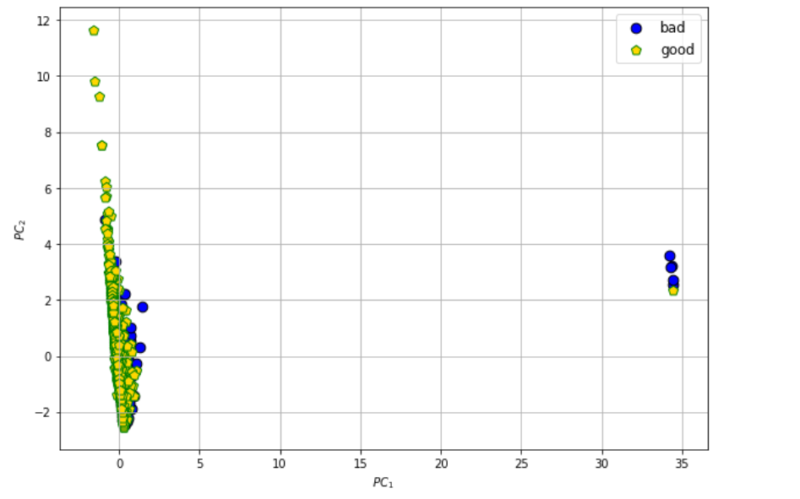
Visualization by PCA(StandardScaler)

Slide 19
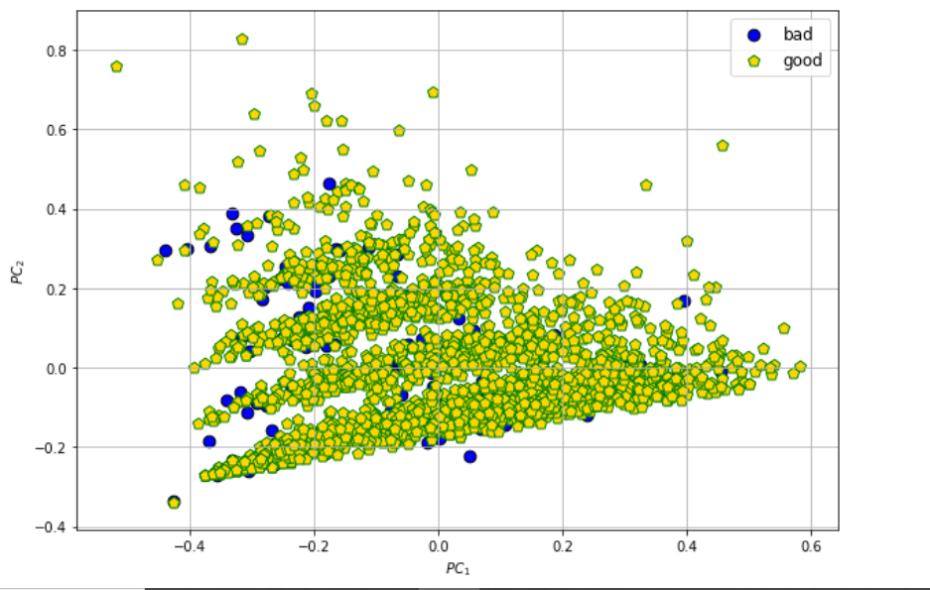
Visualization by PCA(MinMaxScaler)

Slide 20
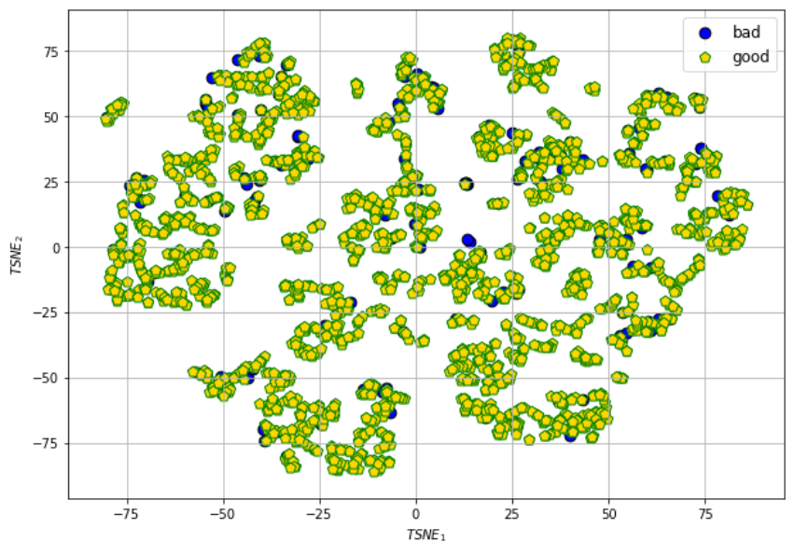
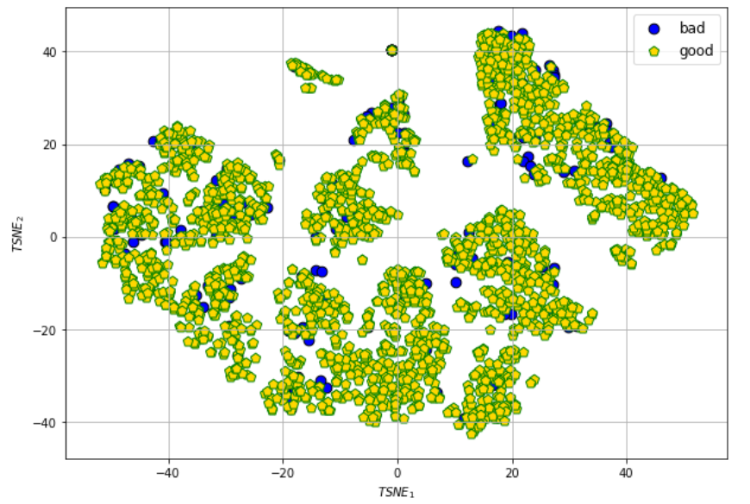
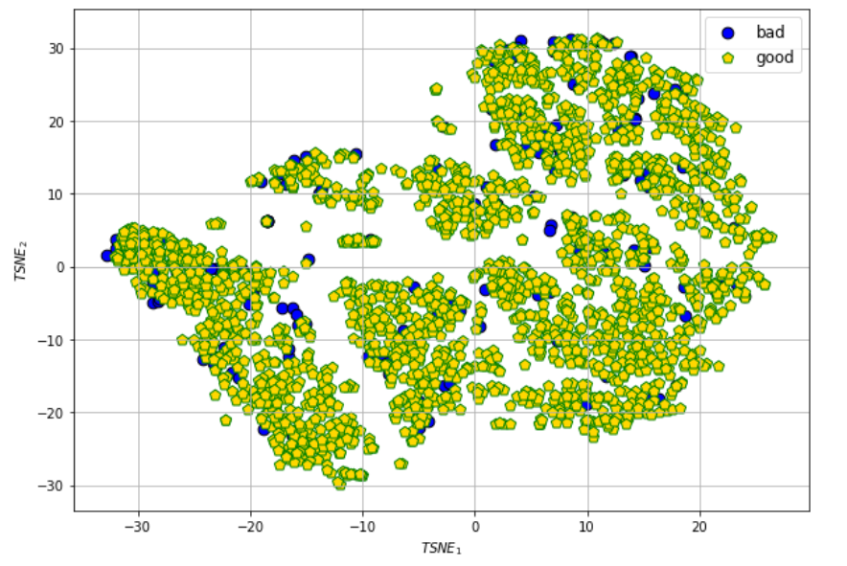
Visualization by TSNE

Slide 21
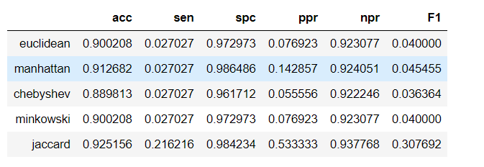
KNN
jaccard>manhattan>minkowski=euclidean>chebyshev

Slide 22
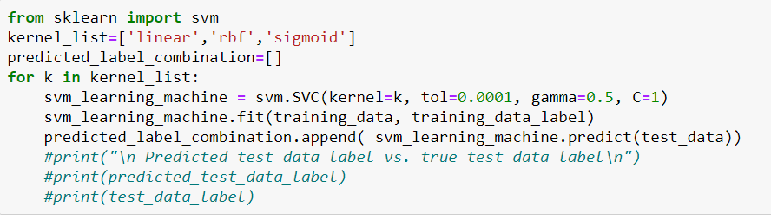
SVM
We chose three kernels : {linear ,rbf, sigmoid} and did svm respectively

Slide 23
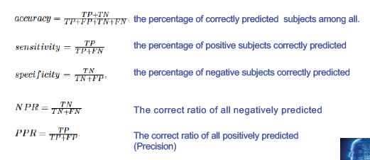

Classification Measures

Slide 24
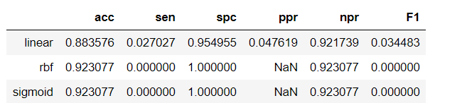
Classification Measures(cont)
1.Rbf and sigmoid kernel both predict all labels are negative. So TP and F1-score are 0.
2.The accuracy of linear kernel is about 88%,which is lower than the other two.

Slide 25
How to overcome the imbalance issue
1.Resample to let all classes have similar size
2.I chose upsample to demonstrate
3.Use resample from sklearn

Slide 26
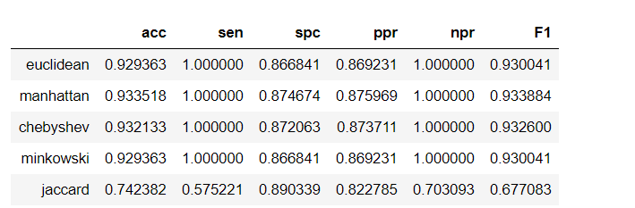
KNN AGAIN
Manhattan performs best

Slide 27
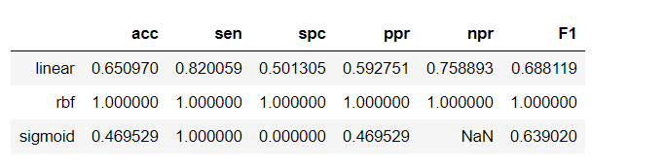
SVM AGAIN
Rbf performs best.

Slide 28
Credit Risk Analytics (III)

Slide 29
Cross validation
By cross validation(k = 10), the mse result is [0.0, 0.0, 0.0, 0.0, 0.0, 0.0, 0.0, 0.0, 0.0, 0.0] with kernel = ‘linear’; [0.0, 0.0, 0.0, 0.0, 0.0, 0.0, 0.011976047904191617, 0.0, 0.005988023952095809, 0.005988023952095809] with kernel=’rbf’; [0.041916167664670656, 0.029940119760479042, 0.029940119760479042, 0.03592814371257485, 0.041916167664670656, 0.05389221556886228, 0.03592814371257485, 0.029940119760479042, 0.05389221556886228, 0.017964071856287425] with kernel = ‘poly‘; [0.0658682634730539, 0.059880239520958084, 0.0658682634730539, 0.04790419161676647, 0.059880239520958084, 0.059880239520958084, 0.029940119760479042, 0.0718562874251497, 0.0718562874251497, 0.04790419161676647] with kernel = ‘sigmoid‘

Slide 30
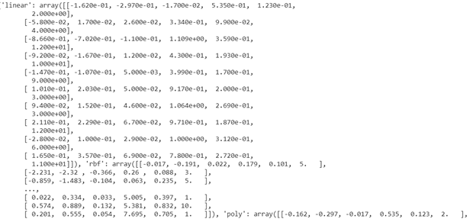
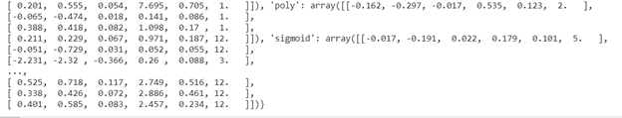
Support Vectors

Slide 31
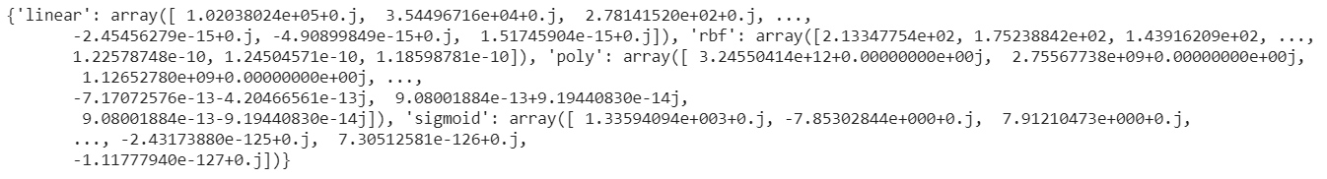
Eigenvalues of kernel matrices

Slide 32
Thank You!

